Slide 1
LINK
GROUP
LINK
Automation Engineering (Shanghai) Co.,Ltd.
GROUP
霖和自动化工程(上海)有限公司
Training Record
Staff name: Nguyễn Tuấn Phong ( Assistant PLC Engineer)
Mainly training: GSC Phase Concept
Phase definition
HMI Support
Programming details

Slide 2
LINK
Phase Definition
GROUP
The production sequence is structured in phases! The individual phases, therefore, are synchronization points at which a system restart must be possible.
Typical phases, of a welding tool for example, are:
Loading
Welding
Unloading
….
Category | Description | Standard signals
PROCESS | Process finished messages | exclusively
TYPE | Type data | exclusively
PART_PRESENT | Component checks | exclusively
MISC | Miscellaneous

Slide 3
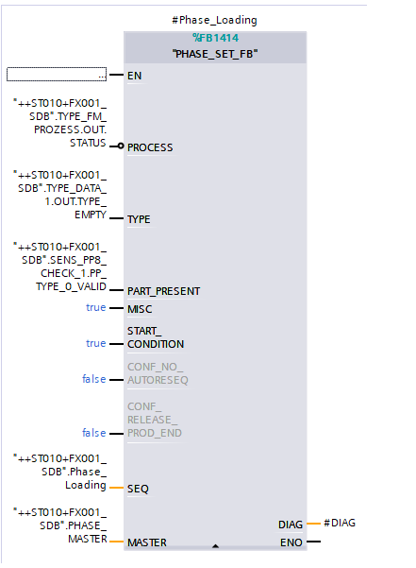
LINK
Phase Definition
GROUP
When restarted, the machine should must which phase is both suitable and possible as a synchronization point. This is only possible if
:PROCESS, TYPE, PART_PRESENT and MISC are fulfilled!
The phase definition must be unique.
ALL phase must differ with respect to the definition of PROCESS, TYPE, PART_PRESENT and MISC.

Slide 4
LINK
Phase Definition
GROUP
When performing resequencing, the first step is for the machine to decide which phase is currently the most useful, i.e. where resequencing is immediately possible. This decision is made exclusively based on the PROCESS, TYPE, PART_PRESENT and MISC information.
System state | Action
Consistent system state | If there is a consistent system state – i.e. if all conditions for a phase are fulfilled – then this phase is automatically selected and the actuators will proceed as defined. A restart is possible immediately!
Inconsistent system state | In this case, HMI dialogs should: indicate that user intervention is required display all relevant phases with the underlying definitions after selecting a phase, use dialogs to provide guidance on how to reach the phase not display possible phases inform the loader/operator that higher authorization levels are required to perform actions or that actions may only be performed by maintenance (more highly qualified personnel)!

Slide 5
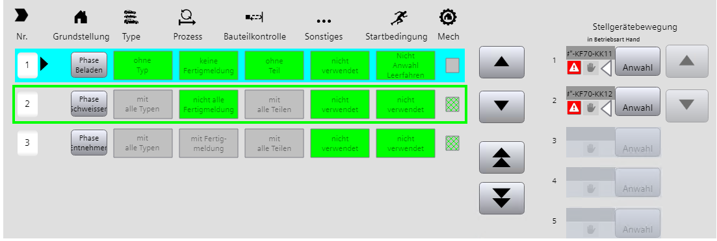
LINK
HMI - Support
GROUP
Consistent system state
The station is in the welding phase (active phase: green border).
If resequencing is now selected, the loading phase is recognized as a consistent phase and resequencing can be started.
Another phase can be selected manually at any time.
Automatic resequencing is then no longer possible -> inconsistent system state

Slide 6
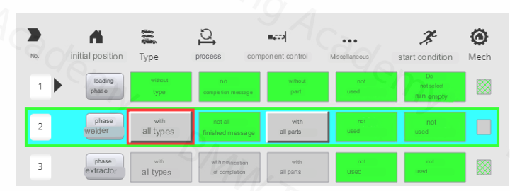
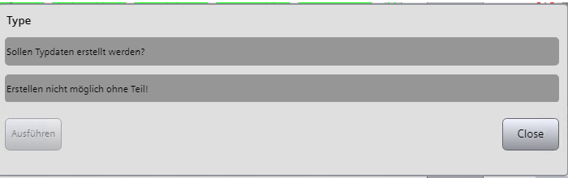
LINK
Phase Definition
GROUP
The corresponding programming must be carried out at PLC level and is described briefly below.
However, it is necessary to define on a project-by-project basis:
whether this methodology has been released
if so, under which premises was it released.
The machine indicates the inconsistencies in succession.
In this case, there is no valid type in the type manager.
The resequencing concept offers the following options:
delete / generate types
delete / generate finished messages.

Slide 7
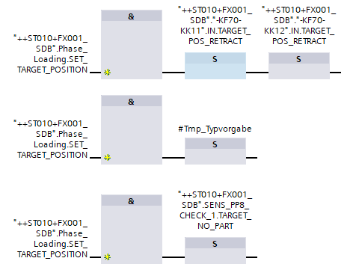
LINK
Phase Definition
GROUP
This definition is relevant to:
generating the overall home position phases.
animating the target state of the actuator position in manually guided resequencing.

Slide 8
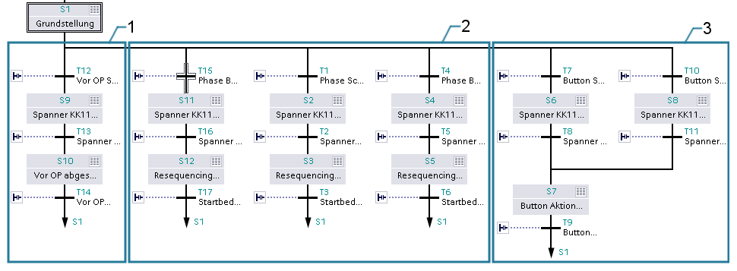
LINK
RESEQ chain structure
GROUP
The resequencing step sequence is always a separate step sequence. The name is more or less identical to the normal sequence chain, just the extension RESEQ instead of SEQ.
When switching to RESEQ mode, the normal sequence chain stops at the last step or the last active steps, but output control is prevented via ZERO_OP.Only after the RESEQ process has been successfully executed and a phase (incl. actuators) has been reached is the RESEQ chain exited again as a conclusion; the normal sequence chain is initialized and the operating mode is changed to MAN.

Slide 9
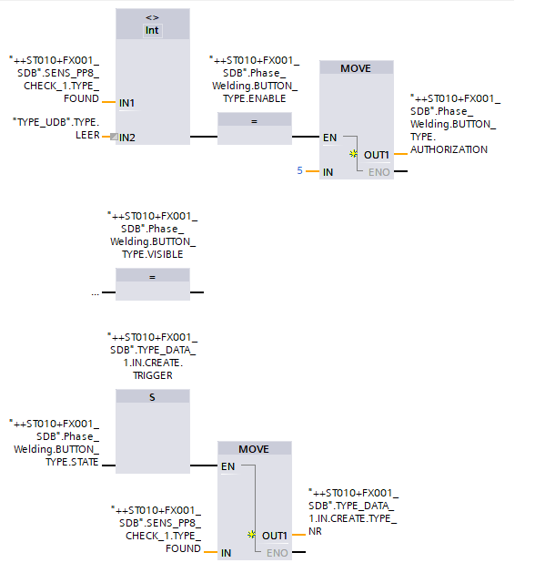
LINK
Further RESEQ elements
GROUP
Delete/generate type
The type information is part of each phase definition.
If a phase is selected for resequencing for which the type status is incorrect, there are button functions
for establishing the required type status: Generate type or delete type.
The programming required for type generation is shown below:
The logic consists exclusively of signals from standard blocks:
SENS blocks
TYPE_DATA_PLACE_FB
Premises:
Generate type: component present, a valid type can be determined via the BTK assignment
Delete type: no component present, BTK assignment does not correspond to an empty tool

Slide 10
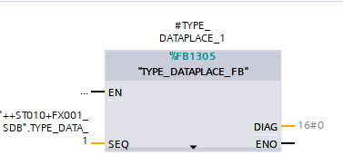
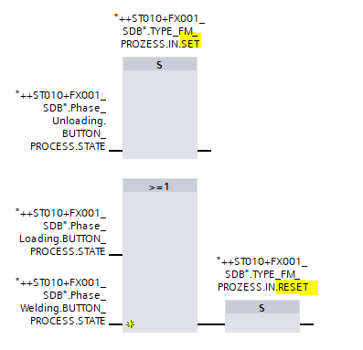
LINK
Further RESEQ elements
GROUP
Delete/generate finished messages
The process status is part of each phase definition.
If a phase is selected for resequencing for which the process status is incorrect, there are button functions
for establishing the required process status: Generate or delete process finished message.
The logic consists exclusively of signals from standard blocks:
SENS blocks
TYPE_DATA_PLACE_FB
The explicit setting/resetting is programmed at the sequence interface of the TYP_FM_PROZESS_FB:

Slide 11
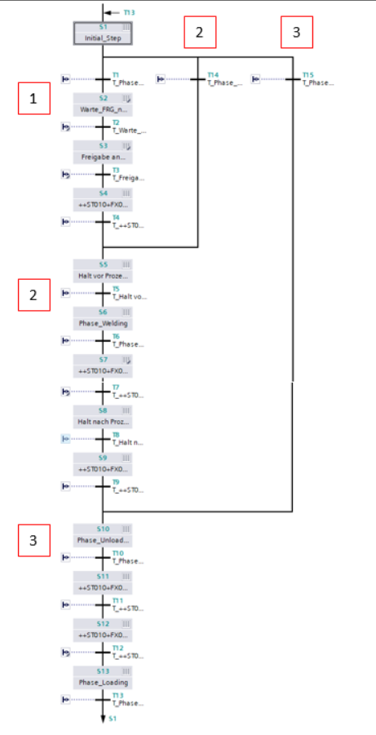
LINK
Programming details
GROUP
As stated in the Phases section,the production sequence is structured in phases!
The individual phases, therefore, are synchronization points at which a system restart must be possible.
Fulfilled phases, then, are step sequence basic positions and act directly affect the overall basic position of a FG!

Slide 12
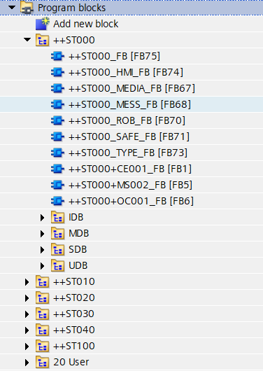
LINK
Software Structure
GROUP
The basic idea of the program structure of the GSC standard is to map the system structure
using the identification system.
Areas with a common operating mode are formed based on the levels in the identification system, which are also made dependent on faults in the corresponding level in the call structure of the TIA project.
So there is the superimposed station ++ST000. Disturbances at this level affect the overall operating mode of the PLC.
Faults in lower levels, such as in the ++ST010, only affect the operating mode area of the ++ST010.
The concept of fault inheritance is also reflected for the selection of the areas on the HMI for manual operation.

Slide 13



Contact Us
LINK Group Headquarter
Shanghai, China
LINK Group North China
Shenyang, China
LINK Group Europe (LKGG GmbH)
Bad Reichenhall, Germany
Enquiry
Enquiry
Enquiry
ying.liu@LKautomation.com
kimi.wang@LKautomation.com
jackey.yin@LKautomation.com
+86 021 6918 0161
+86 021 6918 0161
+86 186 2171 9367
Sales
Sales
Sales
gene.zhang@LKautomation.com
gene.zhang@LKautomation.com
andreas.reymendt@LKautomation.com
+86 136 2179 1621
+86 136 2179 1621
Address
BLDG #D,North Jiasong Road No.3570 Jiading District,Shanghai,P.R.China
Address
NO. 14 22nd Floor,NO.168-3 Harbin Road,
Shenhe District,Shenyang,Liaoning
Province,P.R.China
Address
Fischerbraeuwiese 18b,83435 Bad
Reichenhall,Bavaria,Germany

